Slide 1
Analyzing Vendor payments for a fiscal year using hiveQL
Ejaaz Ahamed, Shaik (CIN - 305087398)
Kiran Kumar Reddy, Thikkam Reddy (CIN - 304470977)
Mounika, Vallabhaneni (CIN - 304746525)

Slide 2
outline
Introduction
Scope of the project
Specifications of Data set
Microsoft Azure HDInsight Cluster Details
Hive Analysis on data using queries
Conclusion
Data set and Github URL

Slide 3
Introduction
Vendor payments reflect disbursements from a state fund for the purchase of goods received, services performed, reimbursements and payments to other governments.
Vendor payment dataset contains payments made by state agencies and institutions of higher education that are processed.
Simplicity on the data analysis and the Estimation of the costs will lay as the main advantages of the project.

Slide 4
Scope of the project
To analyze the total sum of the payment spent by various organizations.
Analysis will be based on the funds allocated to the respective departments and their business units.
The analytics on average amount of expenditure required for the next fiscal year is also calculated.
Amount of expenditure spent with respect to cities and states has also been scrutinized.

Slide 5
Specifications of data set
Data is collected from State of Oklahoma/ Office of Management and Services.
These payments reflect disbursements from a state fund for the purchase of goods received, services performed, reimbursements and payments to other governments.
Travel reimbursements include the Zip Code of the State Capitol and not the individual’s address.

Slide 6
.., continueD
Technical specifications include,
1. File Size – 428.5 MB
2. Number of Files – 1
3. File Format – CSV(Comma Separated Values)
4. Total number of records - 1048576

Slide 7
Microsoft HDInsight cluster Details
Number of Worker nodes – 4
CPU – 16 cores
Number of Head nodes – 2
CPU – 4 cores
Memory – 14GB
Operating system – Windows server 2012

Slide 8
Hive analysis on data using queries
The Hive query language (HiveQL) is the primary data processing method for Treasure Data which is powered by Apache Hive.
Treasure Data is a cloud data platform that allows users to collect, store and analyze their data on the cloud.
Azure HDInsight cluster has been used to perform the analysis using HiveQL.

Slide 9
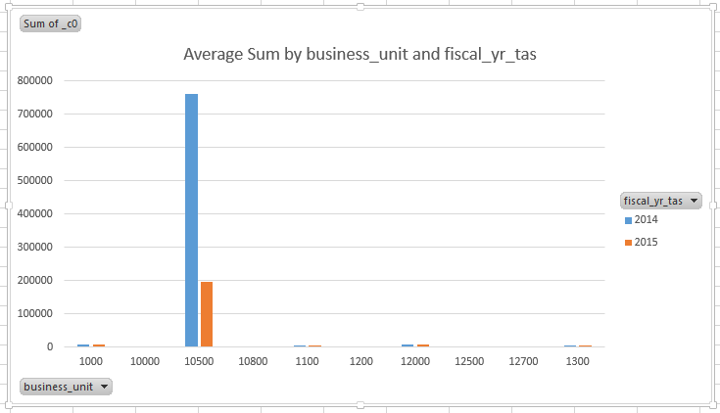
AVERAGE PAYMENT MADE BY EACH BUSINESS UNIT ON FY BASIS
SELECT AVG(PYMNT_AMT), BUSINESS_UNIT, FISCAL_YR_TAS FROM VENDOR_PAYMENTS GROUP BY BUSINESS_UNIT, FISCAL_YR_TAS;

Slide 10
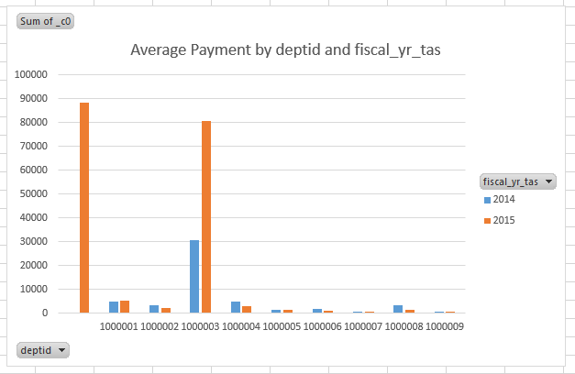
AVERAGE PAYMENT MADE TO EACH DEPARTMENT ON FY BASIS
SELECT AVG(PYMNT_AMT),DEPTID,FISCAL_YR_TAS FROM VENDOR_PAYMENTS GROUP BY DEPTID,FISCAL_YR_TAS;

Slide 11
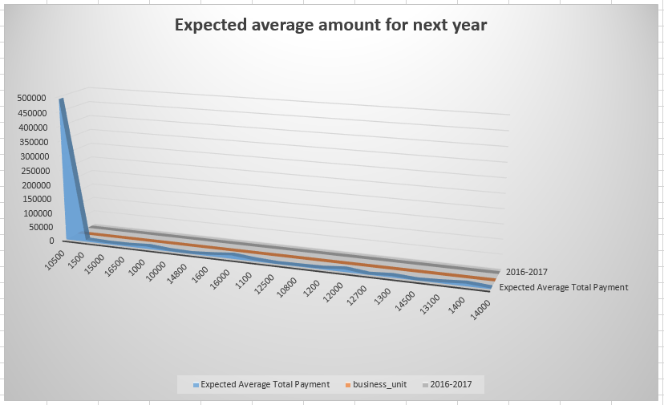
Expected avg amount for next year
SELECT AVG(PYMNT_AMT),BUSINESS_UNIT,'2016-2017' AS FY_YEAR FROM VENDOR_PAYMENTS GROUP BY BUSINESS_UNIT;

Slide 12
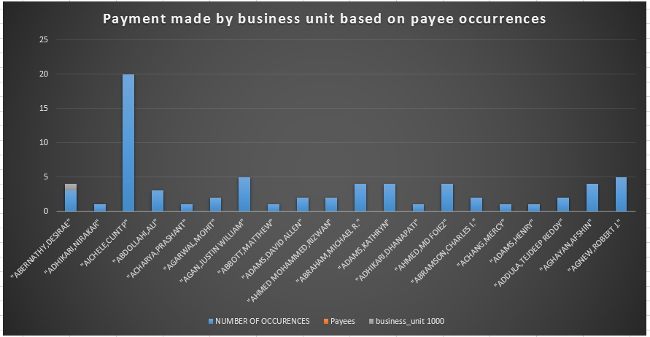
Payment made BY business unit based on payee occurrences
SELECT BUSINESS_UNIT, COUNT(*) AS NUMBER_OF_OCCURENCES, NAME1 FROM VENDOR_PAYMENTS GROUP BY BUSINESS_UNIT, NAME1;

Slide 13
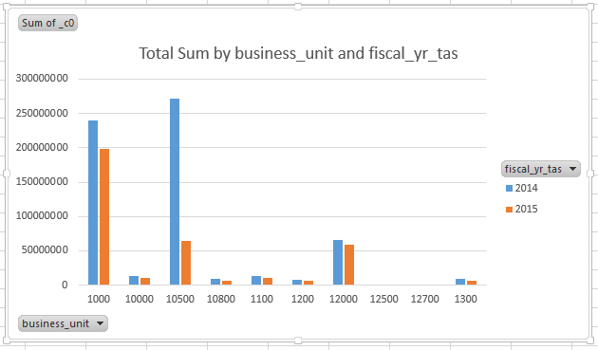
PAYMENT MADE BY EACH BUSINESS UNIT ON FY BASIS
SELECT SUM(PYMNT_AMT), BUSINESS_UNIT, FISCAL_YR_TAS FROM VENDOR_PAYMENTS GROUP BY BUSINESS_UNIT,FISCAL_YR_TAS;

Slide 14
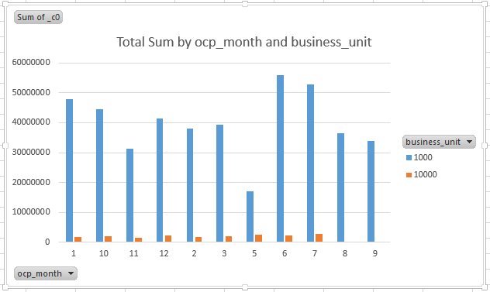
PAYMENT MADE BY EACH BUSINESS UNIT ON MONTHLY BASIS
SELECT SUM(PYMNT_AMT),BUSINESS_UNIT, OCP_MONTH FROM VENDOR_PAYMENTS GROUP BY BUSINESS_UNIT, OCP_MONTH;

Slide 15
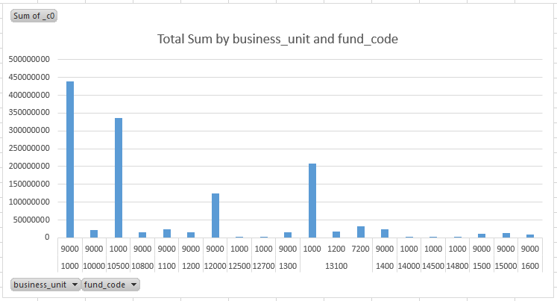
PAYMENT MADE BY EACH BUSINESS UNIT VIA FUND_CODE
SELECT SUM(PYMNT_AMT), BUSINESS_UNIT, FUND_CODE FROM VENDOR_PAYMENTS GROUP BY BUSINESS_UNIT, FUND_CODE;

Slide 16
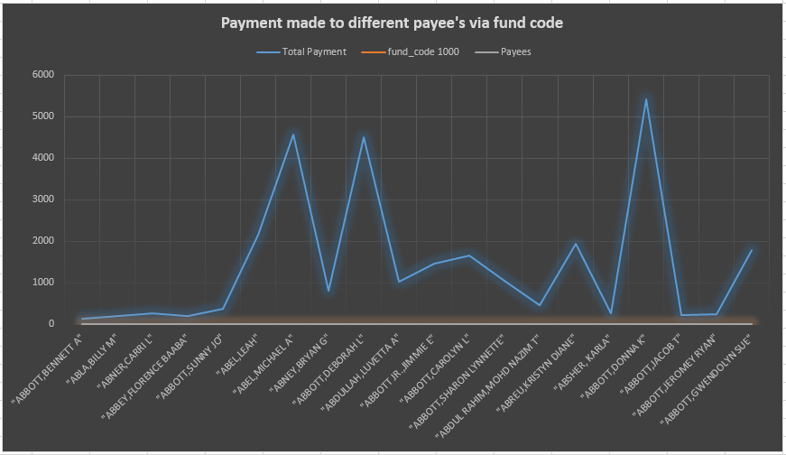
Payment made to different payee's via fund code
SELECT SUM(PYMNT_AMT), FUND_CODE, NAME1 FROM VENDOR_PAYMENTS GROUP BY FUND_CODE, NAME1;

Slide 17
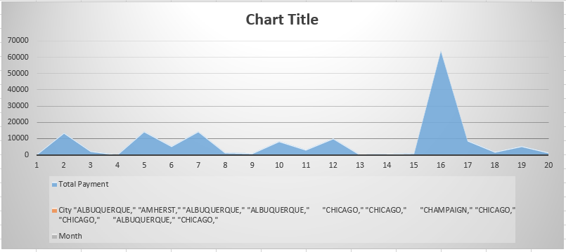
PAYMENT MADE TO EACH CITY ON MONTHLY BASIS
SELECT SUM(PYMNT_AMT),CITY, OCP_MONTH FROM VENDOR_PAYMENTS GROUP BY CITY, OCP_MONTH;

Slide 18
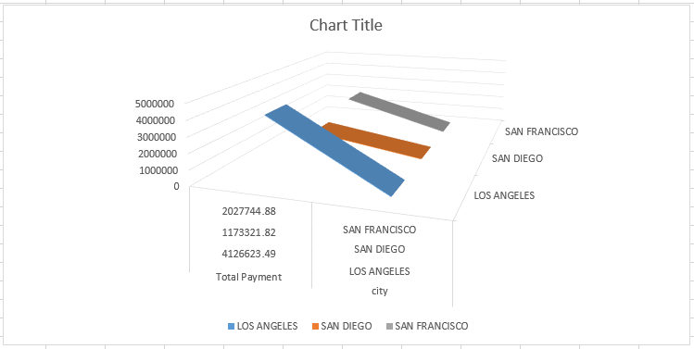
PAYMENT MADE TO EACH CITY(LOS ANGELES, SAN FRANCISCO, SAN DIEGO)
SELECT SUM(PYMNT_AMT), CITY FROM VENDOR_PAYMENTS WHERE CITY IN ('LOS ANGELES', 'SAN FRANCISCO', 'SAN DIEGO') GROUP BY CITY;

Slide 19
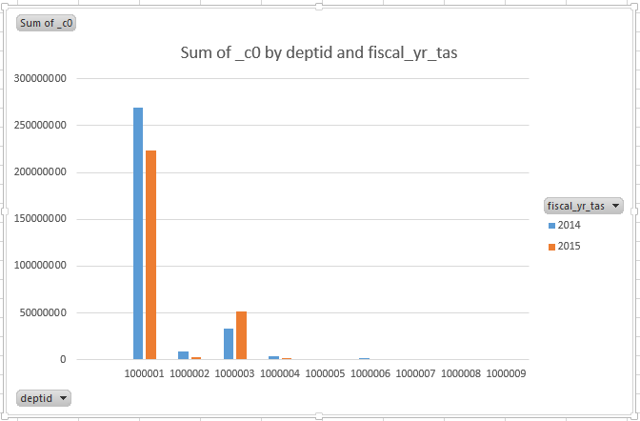
PAYMENT MADE TO EACH DEPARTMENT ON FY BASIS
SELECT SUM(PYMNT_AMT), DEPTID, FISCAL_YR_TAS FROM VENDOR_PAYMENTS GROUP BY DEPTID,FISCAL_YR_TAS;

Slide 20
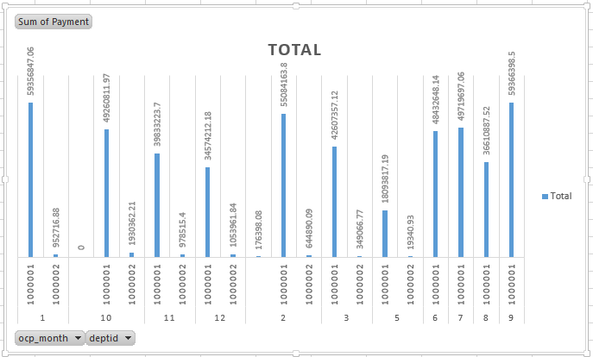
PAYMENT MADE TO EACH DEPARTMENT ON MONTHLY BASIS
SELECT SUM(PYMNT_AMT),DEPTID,OCP_MONTH FROM VENDOR_PAYMENTS GROUP BY DEPTID,OCP_MONTH;

Slide 21
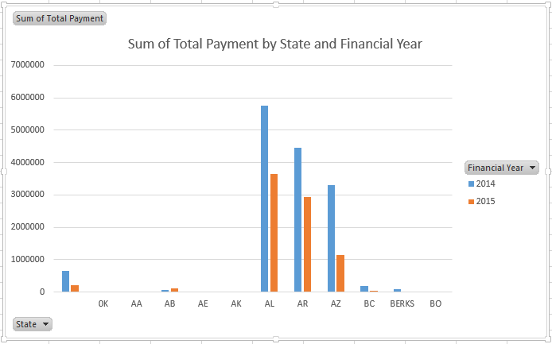
PAYMENT MADE TO EACH STATE ON FY BASIS
SELECT SUM(PYMNT_AMT), STATE,FISCAL_YR_TAS FROM VENDOR_PAYMENTS GROUP BY STATE, FISCAL_YR_TAS;

Slide 22
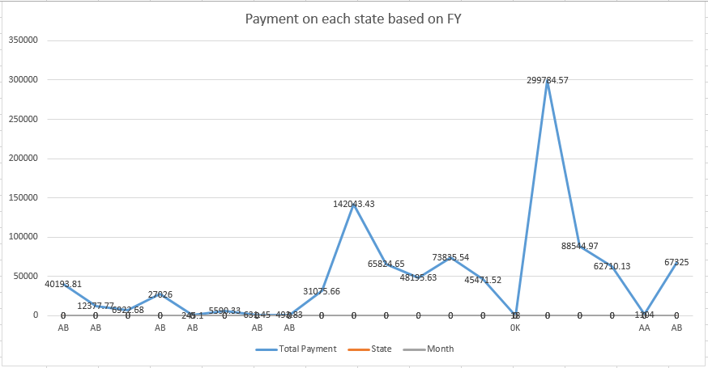
PAYMENT MADE TO EACH STATE ON MONTHLY BASIS
SELECT SUM(PYMNT_AMT), STATE, OCP_MONTH FROM VENDOR_PAYMENTS GROUP BY STATE, OCP_MONTH;

Slide 23
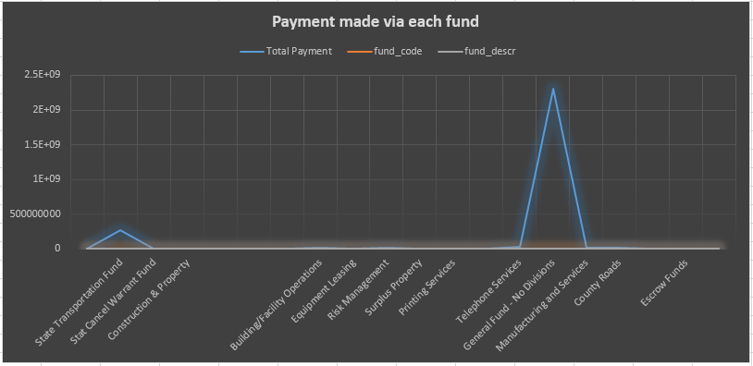
Payment made via each fund
SELECT SUM(PYMNT_AMT), FUND_CODE, FUND_DESCR FROM VENDOR_PAYMENTS GROUP BY FUND_CODE, FUND_DESCR;

Slide 24
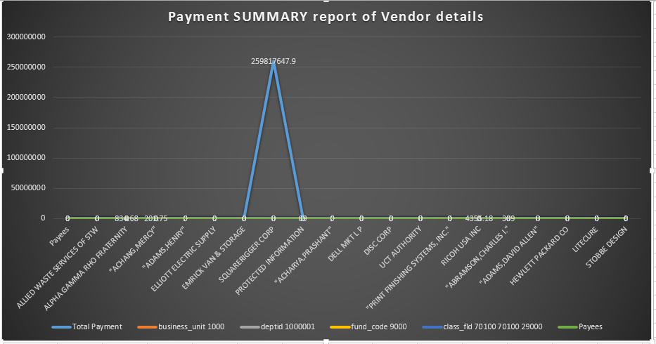
Payment SUMMARY report of Vendor details
SELECT SUM(PYMNT_AMT), BUSINESS_UNIT, DEPTID, FUND_CODE, CLASS_FLD, NAME1 FROM VENDOR_PAYMENTS GROUP BY BUSINESS_UNIT, DEPTID, FUND_CODE, CLASS_FLD, NAME1;

Slide 25
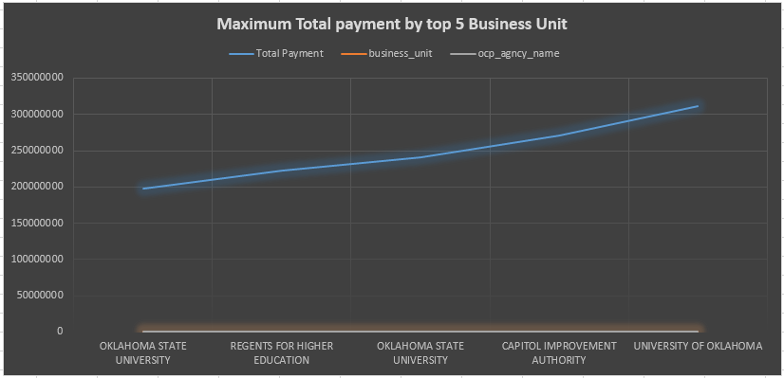
To Find out Max Total Amount paid By Business Unit
SELECT distinct TOTAL_PAYMENT_FY,BUSINESS_UNIT, OCP_AGNCY_NAME FROM (SELECT SUM(PYMNT_AMT) TOTAL_PAYMENT_FY,BUSINESS_UNIT,OCP_AGNCY_NAME, row_number() OVER ( ORDER BY SUM(PYMNT_AMT) DESC) MAX_RANK FROM VENDOR_PAYMENTS GROUP BY BUSINESS_UNIT,OCP_AGNCY_NAME,FISCAL_YR_TAS)A where MAX_RANK <= 5;

Slide 26
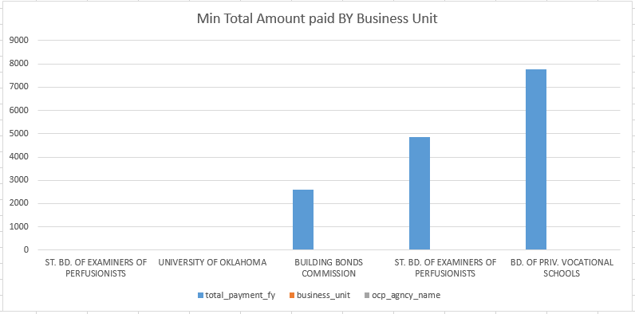
To Find out Min Total Amount paid BY Business Unit
SELECT distinct TOTAL_PAYMENT_FY,BUSINESS_UNIT, OCP_AGNCY_NAME FROM (SELECT SUM(PYMNT_AMT) TOTAL_PAYMENT_FY,BUSINESS_UNIT, OCP_AGNCY_NAME, row_number() OVER ( ORDER BY SUM(PYMNT_AMT) ASC) MAX_RANK FROM VENDOR_PAYMENTS GROUP BY BUSINESS_UNIT,OCP_AGNCY_NAME, FISCAL_YR_TAS)A where MAX_RANK <= 5;

Slide 27
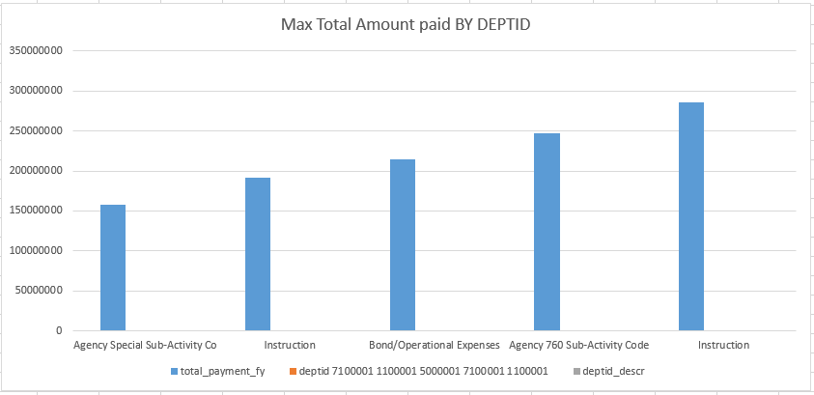
To Find out Max Total Amount paid BY DEPTID
SELECT distinct TOTAL_PAYMENT_FY, DEPTID, DEPTID_DESCR FROM (SELECT SUM(PYMNT_AMT) TOTAL_PAYMENT_FY, DEPTID, DEPTID_DESCR,row_number() OVER ( ORDER BY SUM(PYMNT_AMT) DESC) MAX_RANK FROM VENDOR_PAYMENTS GROUP BY DEPTID, DEPTID_DESCR, FISCAL_YR_TAS)A where MAX_RANK <= 5;

Slide 28
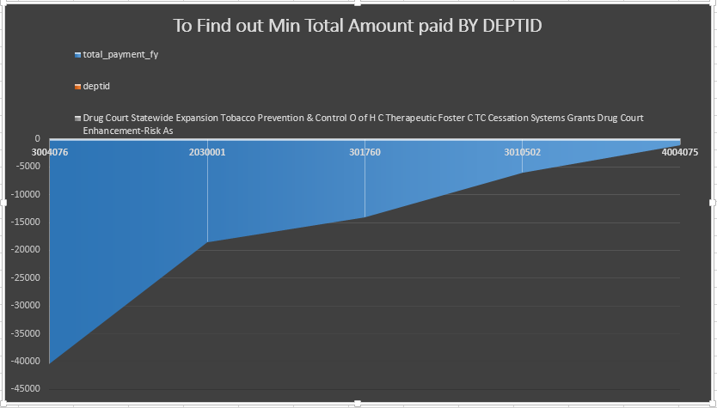
To Find out Min Total Amount paid BY DEPTID
SELECT distinct TOTAL_PAYMENT_FY, DEPTID, DEPTID_DESCR FROM (SELECT SUM(PYMNT_AMT) TOTAL_PAYMENT_FY, DEPTID, DEPTID_DESCR, row_number() OVER ( ORDER BY SUM(PYMNT_AMT) ASC) MAX_RANK FROM VENDOR_PAYMENTS GROUP BY DEPTID, DEPTID_DESCR, FISCAL_YR_TAS)A where MAX_RANK <= 5;

Slide 29
Conclusions
A clear insight on the average amount of payments for various departments and their numerous business units has been articulated.
An average payment amount for a fiscal year of various business units has been calculated to cut down the unnecessary costs.
Individual monthly and fiscal year payment details of funds allocated, business units and departments of their respective States and Cities has been cited.

Slide 30
Github and data set details
http://catalog.data.gov/dataset/state-of-oklahoma-vendor-payments-fiscal-year-2015
https://github.com/ejyshaik/Vendor-Payments

Slide 31



